Slide 1
An Examination of the Financial and Economic Impact US Exchange Rate Volatility Has on Fixed Income Securities for Chinese Investors
Dr. A. Frank Thompson
Sam Kolahgar
Azadeh Babaghaderi
Famao Zhang
UNL College of Business
England-Clark Conference
April 2011

Slide 2
Analysis of the Motivations for US Government Bond Investment and the Impact Exchange Rates Have on Real Income and Bond Pricing
Introduction
A bond’s worth to the investor is directly tied to the purchasing price of the currency in which the cash flows are stated.
The real value of US Government Bonds to the Chinese investor will depend on the movement of both interest and exchange rates over the holding period.
Higher market interest rates will reduce bond prices and produce capital deprecation.

Slide 3
Analysis of the Motivations for US Government Bond Investment and the Impact Exchange Rates Have on Real Income and Bond Pricing (cont.)
Scenario: Exchange rate decline
Decline in US Dollar/Chinese Yuan exchange rate
Decline in value of the US Treasury Bond`s cash flows
stated in Chinese Yuan
Decline in Motivation of Chinese investors for buying or retaining these securities Decline
Increase in Chinese investors` expected rate of return

Slide 4
Key Literature References 0n the Impact Interest and Exchange Rate Movements have on Bond Income and Pricing
Domestic and foreign currencies are assumed to be perfect substitutes with domestic interest rates moving according to investor expectations about domestic currency changes in correspondence to their foreign currency counterparts. (Dornbusch, 1976)
When exchange rate variability is large, risk reduction opportunities may be significant for international diversified portfolios that hedge currency risk.
(Kaplanis and Schaefer, 1991)
Uncertainty with respect to exchange rate fluctuation between two country currencies motivates investors to purchase or sell equity positions in the domestic or foreign markets based on arbitrage possibilities.
(Zapatero , 1995)

Slide 5
Key Literature References 0n the Impact Interest and Exchange Rate Movements have on Bond Income and Pricing
International diversification among government bonds may not necessarily yield significant risk reduction benefits especially when they are not hedged against currency risks.
(Hansson, Liljeblom and Löflund, 2009)
Real exchange rate shocks have been less relevant in explaining US trade balance movements than asset or housing prices; So, large exchange rate movements may not necessarily be key in adjusting today’s large US current trade account imbalances.
(Fratzscher, Juvenal, and Sarno, 2010)

Slide 6
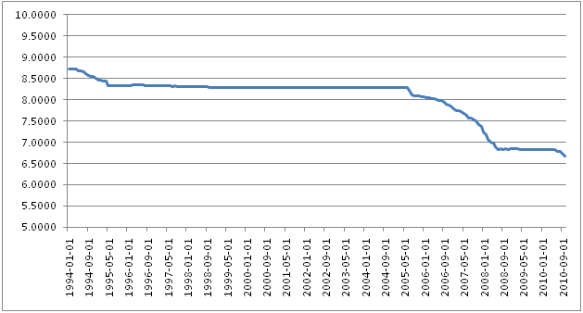
Analysis of Historical US and Chinese Currency Rate Changes and Their Impact on US Government Bond Pricing and Returns to Chinese Investors
US Dollar/ Chinese Yuan Exchange Rates
January 1, 1994 to October 1, 2010
Source: Federal Reserve District Bank of St. Louis, Economic Research Data – FRED, http://www.stlouisfed.org/

Slide 7
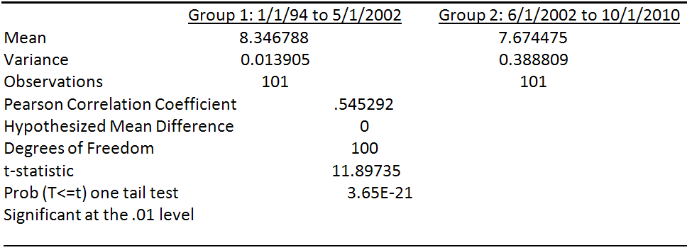
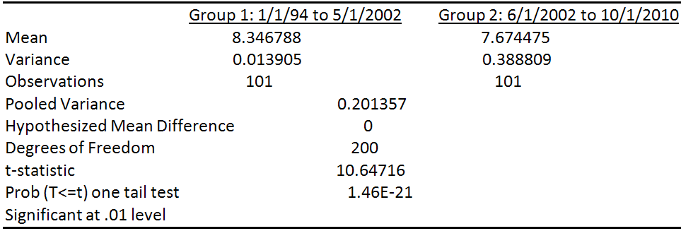
Analysis of Historical US and Chinese Currency Rate Changes and Their Impact on US Government Bond Pricing and Returns to Chinese Investors
Difference of Two Means Test (H₀: Group Means are Equal)
Difference of Two Means Test (H₀: Group Variances are Equal)

Slide 8
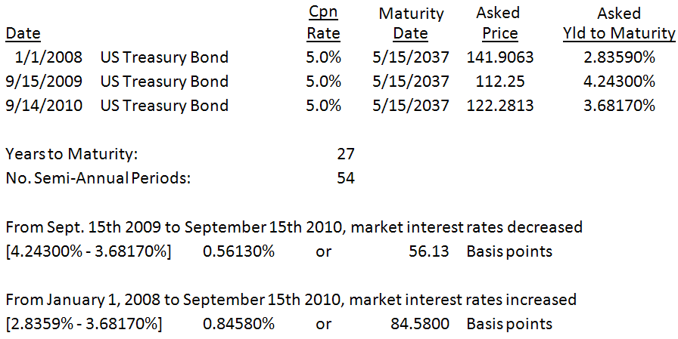
Analysis of Interest Rate Risk on the Pricing and Investor Return on a US Treasury Bond
Bond to be analyzed:

Slide 9
Analysis of an Investor's Return Denominated in US Dollars from a Change in Interest Rates
One Year Scenario: Purchase of US Government Bond in 2009 followed by a Sale One Year Later in 2010 on September 15th
Date | Transaction | Bond Price $
9/15/2009 | Buy | 112.25
9/15/2010 | Sell | 122.2813
Investor`s Rate
of Return
8.94%
Two Year Scenario: Purchase of US Government Bond on January 1, 2008 followed by a Sale One Year Later in 2010 on September 15th
Date | Transaction | Bond Price $
1/1/2008 | Buy | 141.9063
9/15/2010 | Sell | 122.2813
Investor`s Rate
of Return
-13.83%

Slide 10
Analysis of a Chinese Investor's Return Denominated in US Dollars from a Change in Interest Rates
One Year Scenario: Purchase of US Government Bond in 2009 followed by a Sale One Year Later in 2010 on September 15th
Date | Transaction | Bond Price $ | Ex. rate
9/15/2009 | Buy | 112.25 | 6.8289
9/15/2010 | Sell | 122.2813 | 6.74217
Investor`s Rate
of Return
7.55%
Two Year Scenario: Purchase of US Government Bond on January 1, 2008 followed by a Sale One Year Later in 2010 on September 15th
Date | Transaction | Bond Price $ | Ex. rate
1/1/2008 | Buy | 141.9063 | 7.2946
9/15/2010 | Sell | 122.2813 | 6.74217
Investor`s Rate
of Return
-20.36%

Slide 11
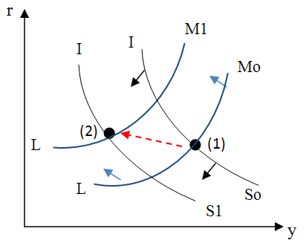
Examination of Currency and Interest Rate Fluctuations for the US Economy using Static Macroeconomic Analysis
IS-LM Equilibrium With Increase in American prices (P^{US})

Slide 12
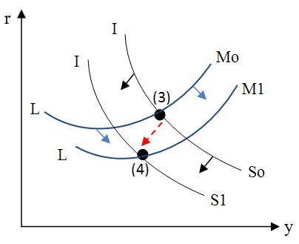
Examination of Currency and Interest Rate Fluctuations for the US Economy using Static Macroeconomic Analysis
Initial IS-LM Equilibrium with Increase in exchange rate (P^{e})

Slide 13
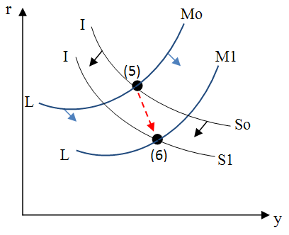
Examination of Currency and Interest Rate Fluctuations for the US Economy using Static Macroeconomic Analysis
Longer Run IS-LM Equilibrium with Increases in P^{e}

Slide 14
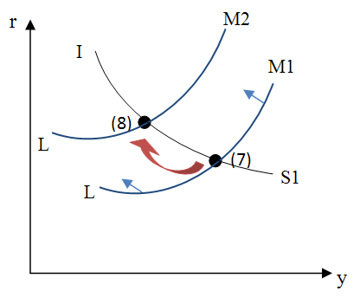
Examination of Currency and Interest Rate Fluctuations for the US Economy using Static Macroeconomic Analysis
New Long-Term Equilibrium Based on Chinese US Treasury Bond Sales

Slide 15
Conclusion and Policy Implications
A micro-economic analysis of the impact declining US Dollar/Chinese Yuan exchange has on US Treasury bond prices indicates continued reductions in the US dollar against the Chinese home currency may result in further investment loss to long-term Chinese investors.
In such a situation, a prudent investor may sell the money losing holding in favor of investments such as physical assets or financial securities in countries with stronger currencies, in an effort to obtain a more stable store of value over time.

Slide 16
Conclusion and Policy Implications (Cont.)
These investment losses may motivate Chinese to sell US Treasury securities causing declines in bond prices, and increases in interest rates in the US capital market.
US Dollar/Chinese Yuan currency exchange policy needs to consider not only trade balance issues, but also the interests of Chinese investors who hold considerable positions in US Government bonds.
This perspective derived from micro and macro economic analysis may be important not only from the standpoint of maintaining Chinese interest in US Government bonds as an investment, but also for maintaining stability of the US Government bond market and monetary policy.

Slide 17
Thank you for your attention

